Slide 1
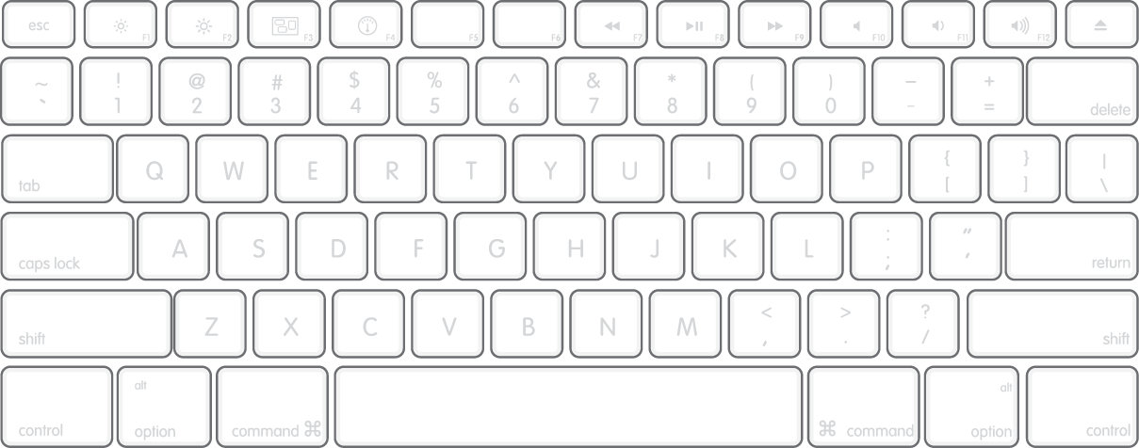
Note: bindings marked in parentheses are used with the shift key. These are faster versions of the commands
TRANSITIONS ALIGNED BEATJUMPS:
Zoom +
(zoom =)
Zoom -
Lock A+B
(UnL A+B)
CF ~`<-
(CF <<)
CF ->
(CF|)
CF <-
(CF >>)
Play A+B
(Pause A+B)
Play A
(Front A
[Cue A]
JP A <-
(JP A <<-)
[LFine <]
JP A ->
(JP A ->>) [LFine >]
(Del Cue A)
Del BM A
()
Set BM A
()
Play B
(FrontB [Cue B]
JP A <-
(JP A <<-) [Lfine <]
JP B ->
(JP B ->>)
[Lfine >]
(Del Cue )
Del BM B ()
Set BM B ()
P A+B
(C A+B)
Jump (A+B <-)
Jump
(A+B ->)

Slide 2
